Slide 1

Practical Course: XML Technology
BlackJack in XML
Supervisor: Prof. Dr. Anne Brüggemann-Klein
Developers: Robert Urban, Anne-Catherine Seeser, Lennert Rienau,
Michael Mitterer, Lennert Rienau,
Manuel Ehler
Garching, 08/30/2017

Slide 2
Agenda
Introduction
Technologies
Design and Implementation
Architecture
Testing
Development
Conclusion
Demo

Slide 3




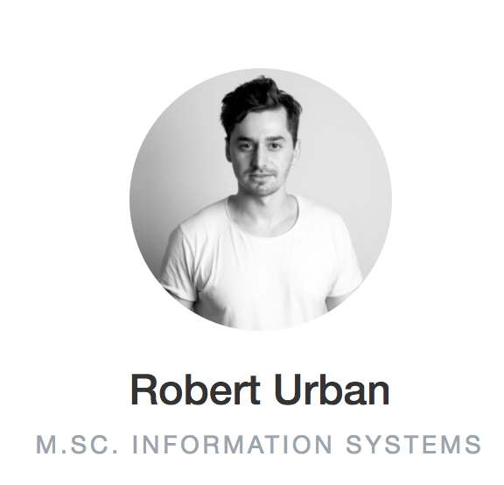
1. Introduction - Team
Introduction
Technologies
Design
Architecture
Testing
Development
Conclusion
Demo

Slide 4

1. Introduction - Requirements
BlackJack Game as Web Application with XML Stack
GUI with SVG and XSLT transformation
URL mapping with RestXQ
Several Games controlled by server logic and BaseX database
UML Classdiagram
DocBook documentation with design implications and reflection
Introduction
Technologies
Design
Architecture
Testing
Development
Conclusion
Demo

Slide 5
2. Technologies
DocBook
XML
Xquery
SVG
XSLT
XHTML
Introduction
Technologies
Design
Architecture
Testing
Development
Conclusion
Demo

Slide 6
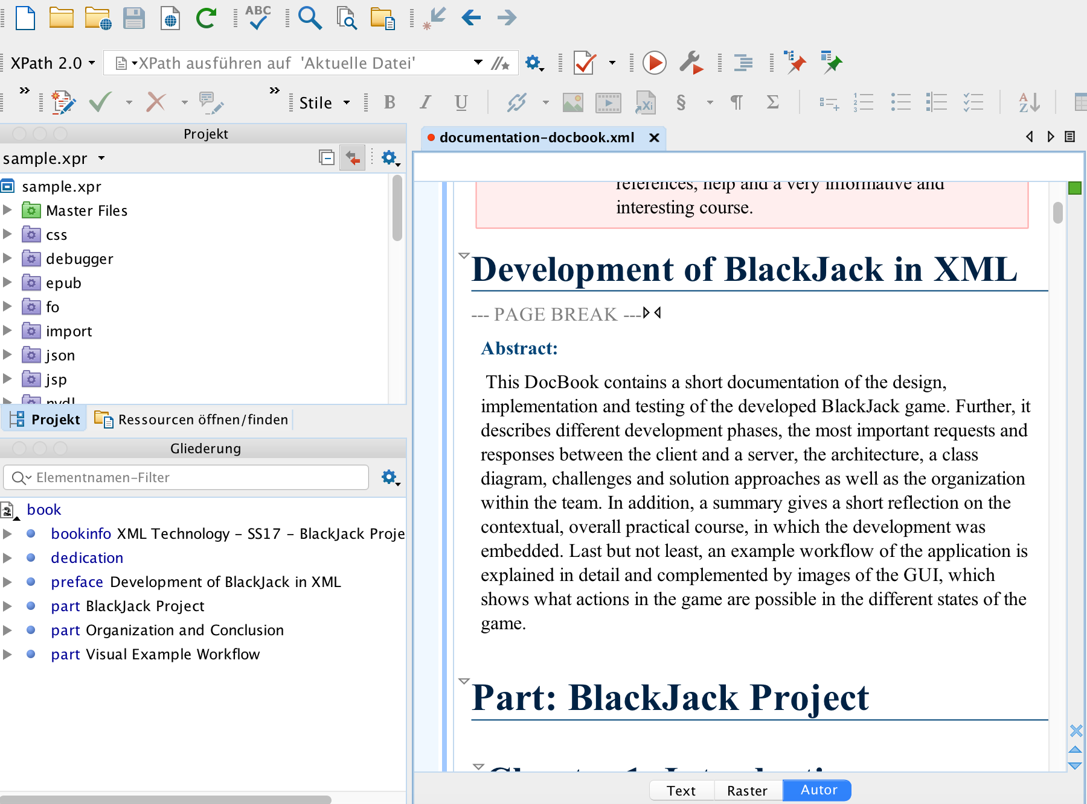
2. Technologies - DocBook
Project documentation
with DocBook
Introduction
Technologies
Design
Architecture
Testing
Development
Conclusion
Demo

Slide 7
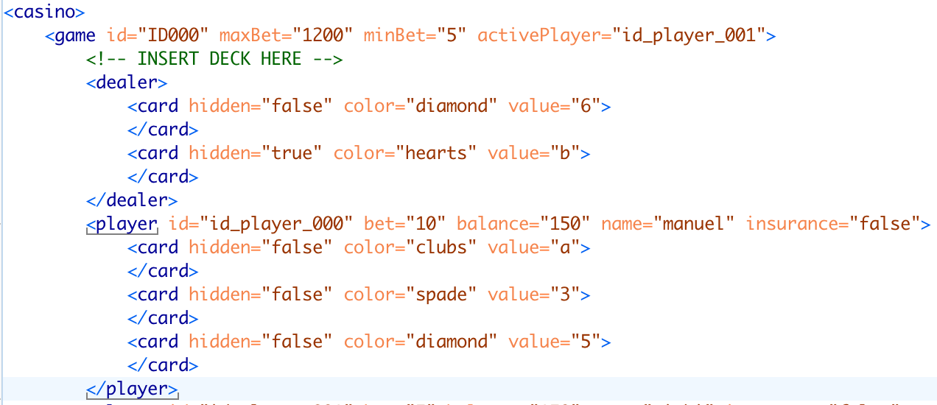
2. Technologies - XML
Markup language, which defines a set of encoding rules for digital documents
Introduction
Technologies
Design
Architecture
Testing
Development
Conclusion
Demo
Notes:
Code nicht lesen ☺

Slide 8
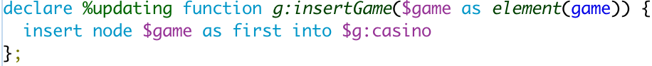
2. Technologies - XQuery
For finding and
extracting data
from large XML
documents
Introduction
Technologies
Design
Architecture
Testing
Development
Conclusion
Demo

Slide 9
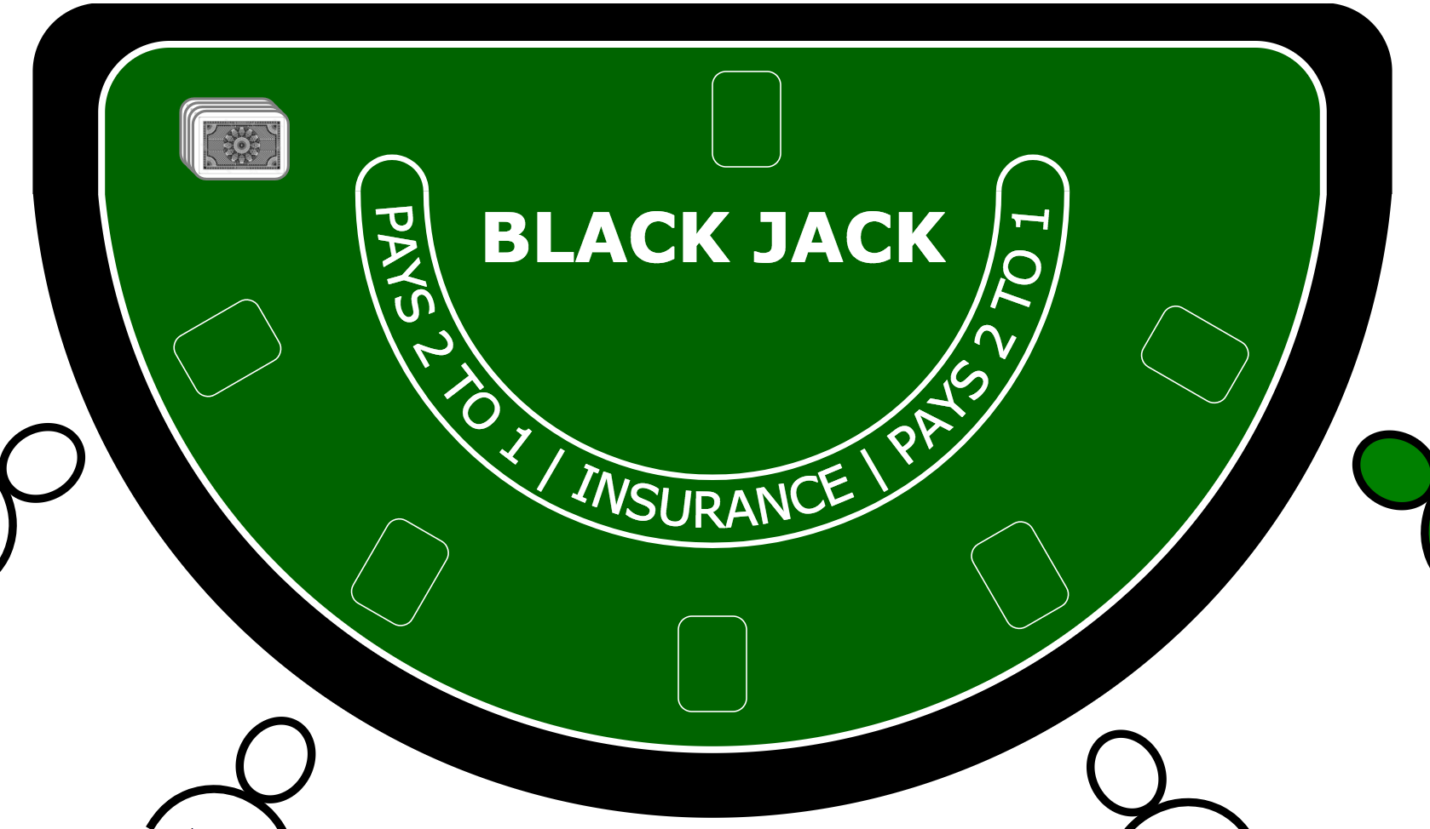
2. Technologies - SVG
Enables vector based
graphics
Introduction
Technologies
Design
Architecture
Testing
Development
Conclusion
Demo

Slide 10
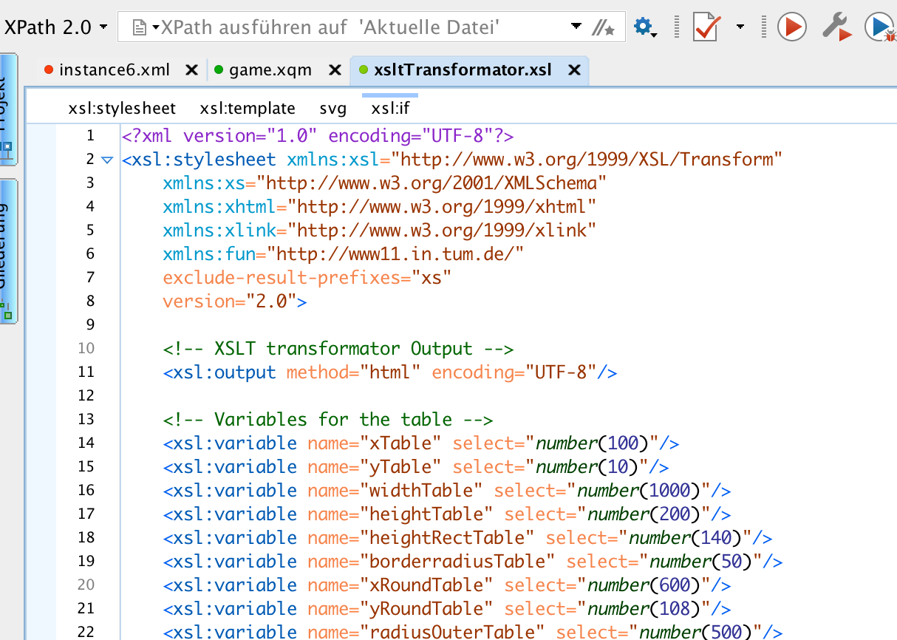
2. Technologies - XSLT
for transforming XML documents into other XML documents, or other formats such as HTML for web pages
Introduction
Technologies
Design
Architecture
Testing
Development
Conclusion
Demo

Slide 11
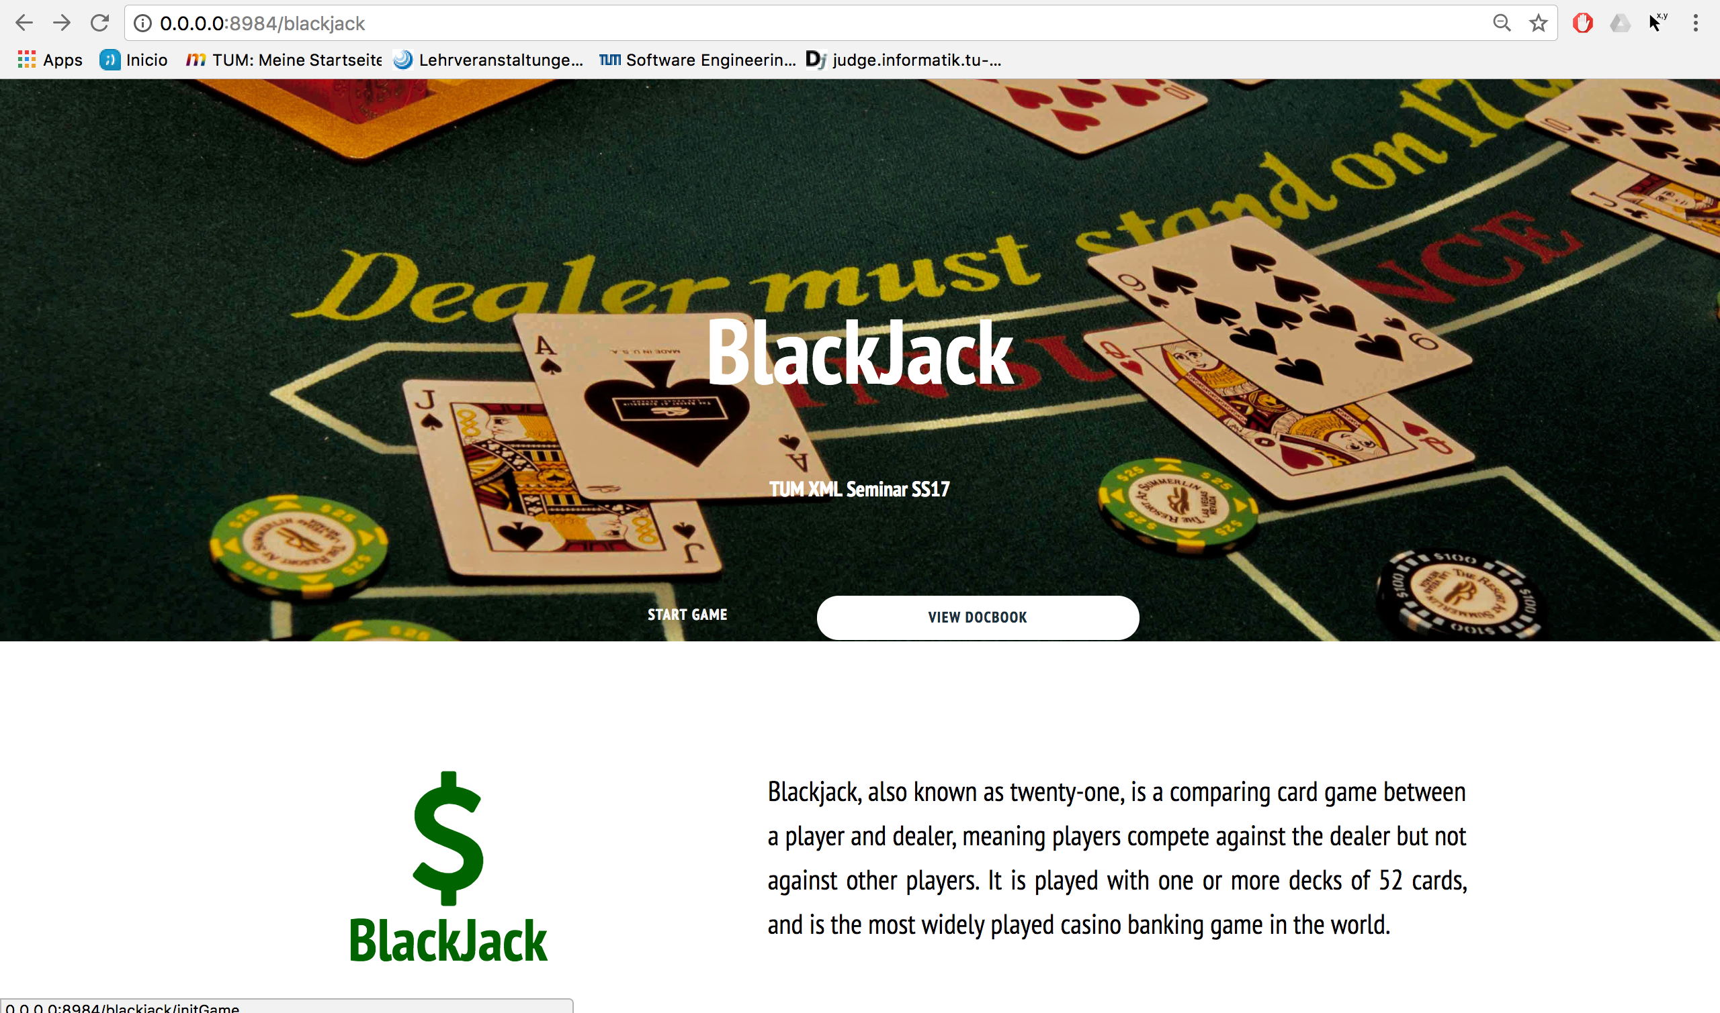
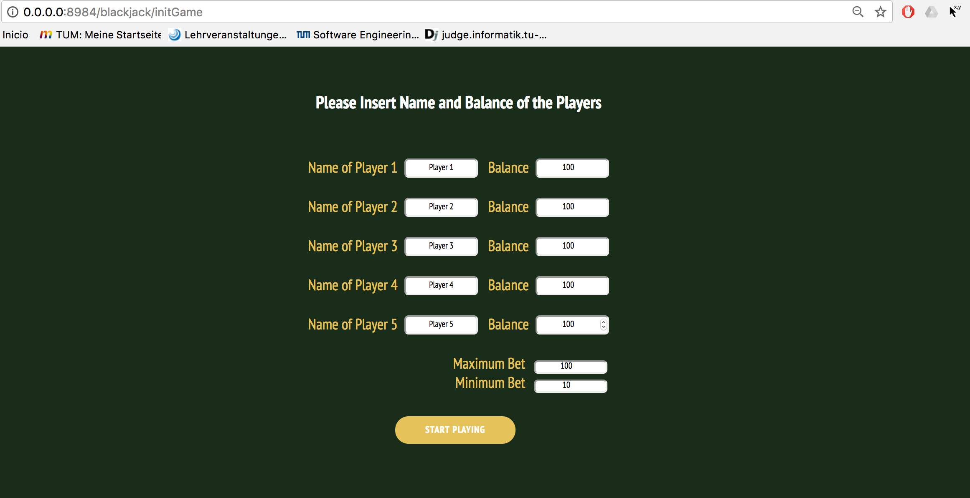
2. Technologies - XHTML
Defines structure of web
pages
Introduction
Technologies
Design
Architecture
Testing
Development
Conclusion
Demo

Slide 12
3. Design and Implementation
Rules
Number of players
Card deck
Drawing cards
Player actions
Bet
Insurance
Hit
Stand
Winnings status and winnings
Dealer wins against player
Player wins against dealer
Tie between player and dealer
→ Realistic casino experience!
Introduction
Technologies
Design
Architecture
Testing
Development
Conclusion
Demo

Slide 13
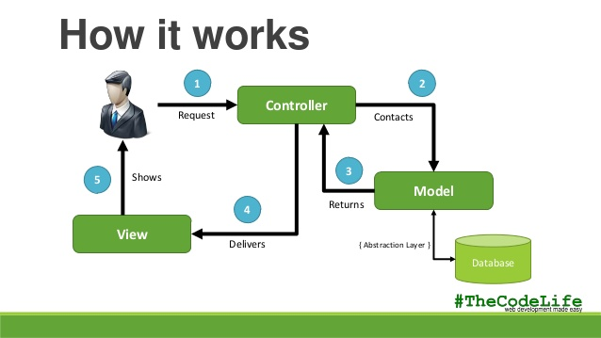
4. Architecture – MVC
Source: https://image.slidesharecdn.com/modelviewcontrollermvc-140211001124-phpapp01/ 95/model-view-controller-mvc-6-638.jpg?cb=1392077579, accessed on 08/23/17 at around 04:19 PM
Introduction
Technologies
Design
Architecture
Testing
Development
Conclusion
Demo

Slide 14
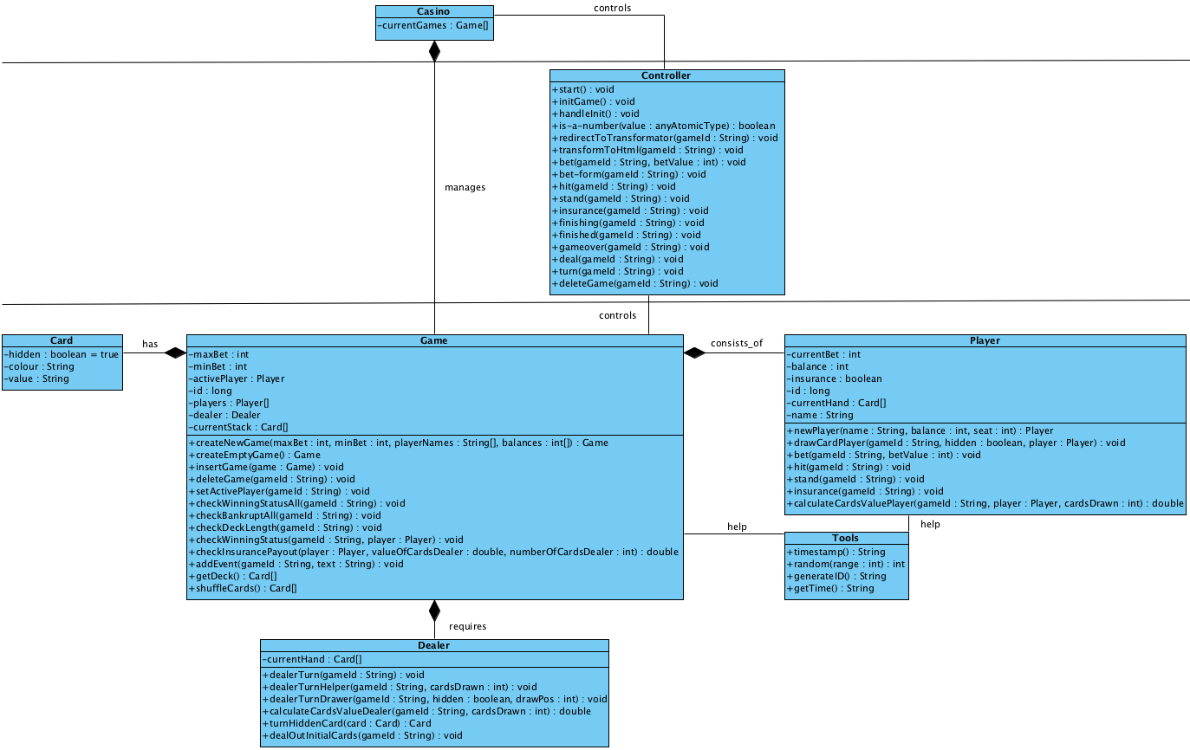
4. Architecture – Class Diagram
Introduction
Technologies
Design
Architecture
Testing
Development
Conclusion
Demo
Notes:
Entscheidung: nur zwei Attribute statt drei zu verwalten, Beim Zusammenzählen muss aufgrund von Ass sowieso geprüft und übersetzt werden
Color (suits, hearts, piks, …)
Value (2-10, J,Q,K,A (weil 1 oder 11))
Diskussion wegen Table und Game => Ist das Selbe
Minimum Bet and Maximum Limit if Game is created
Spiel läuft sequentiell ab, deswegen brauchen wir nur einen aktiven Spieler, also der, der gerade mit dem Dealer in Interaktion ist (Player: aktiv in der Klasse Game)
Frage? Spielt der Dealer noch weiter, wenn alle Spieler über 21 sind?
- Falls ein Spieler über 21 kommt, ist der Spieler sofort raus und der Dealer zieht keine Karte mehr
- Letzter Spieler und alle über 21, muss der Dealer keine mehr ziehen
Safety des Spielverlaufs, nur ein Spieler aktiv in Klasse Game.
Sobald der Kartenstapel unter x oder 60% des Stapels ist, wird neu gemischt.
Turn ist bei Dealer, weil nur die zweite Dealer Karte geturned wird.
Game und Player haben eine Id, Card ist eindeutig über Attribute und es gibt nur ein Casino.

Slide 15
5. Testing
Unit tests
Integration test
Borderline cases
Reviews
Introduction
Technologies
Design
Architecture
Testing
Development
Conclusion
Demo

Slide 16
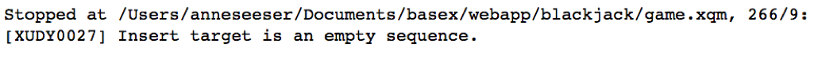
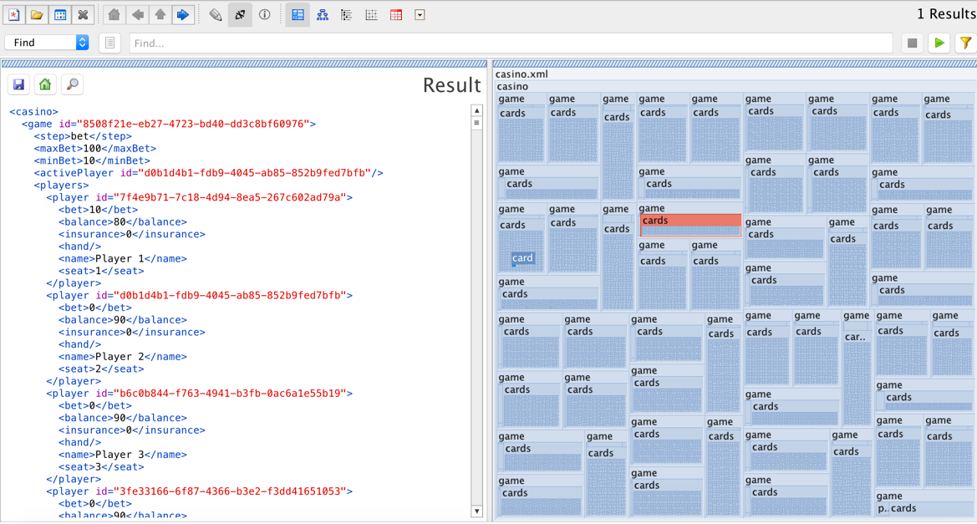
5. Testing - Unit Test
individual units of source code are tested, to determine whether they are fit for use.
Introduction
Technologies
Design
Architecture
Testing
Development
Conclusion
Demo

Slide 17
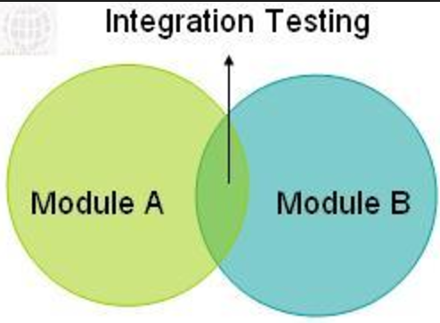
5. Testing - Integration Test
individual software modules are combined and tested as a group
Introduction
Technologies
Design
Architecture
Testing
Development
Conclusion
Demo

Slide 18
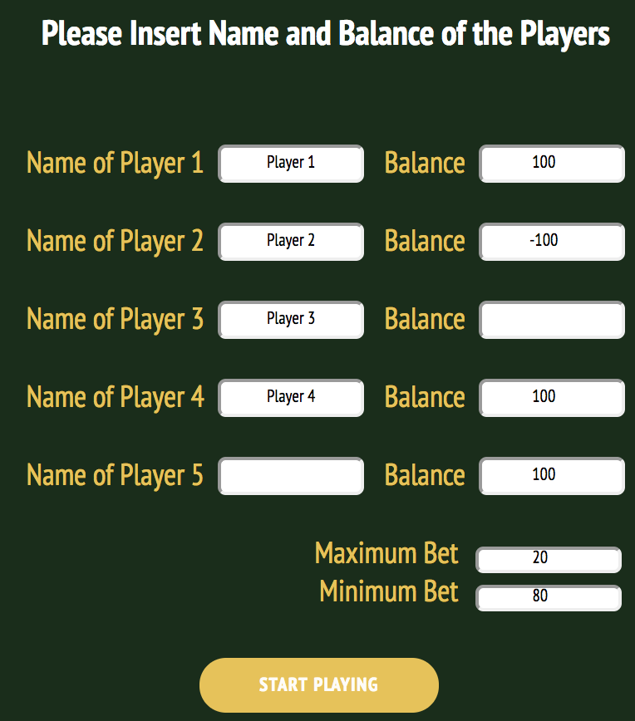
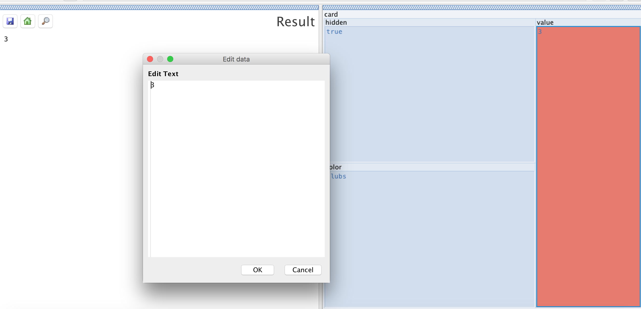
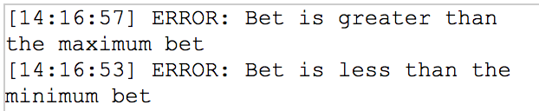
5. Testing - Borderline Cases
Introduction
Technologies
Design
Architecture
Testing
Development
Conclusion
Demo

Slide 19

5. Testing - Reviews
Double and triple check the written
code of each others by reviews
→ High implementation quality
Introduction
Technologies
Design
Architecture
Testing
Development
Conclusion
Demo

Slide 20



6. Development – Environment
Sources: https://www.oxygenxml.com/img/mb_xml_editor.png , accessed on 08/28/17 at around 05:55 PM
http://basexgmbh.de/wp-content/uploads/2013/04/BaseX-300x252.png , accessed on 08/28/17 at around 06:00 PM
https://www.aha.io/assets/github.7433692cabbfa132f34adb034e7909fa.png , accessed on 08/28/17 at around 06:00 PM
Introduction
Technologies
Design
Architecture
Testing
Development
Conclusion
Demo
Notes:
Tools und Methoden:
Oxygen, BaseX -> Gemeinsame Plattform -> Helfen
GitHub -> Gleichzeitiges Arbeiten, Übersicht über Änderungen, Versionsmanagement

Slide 21
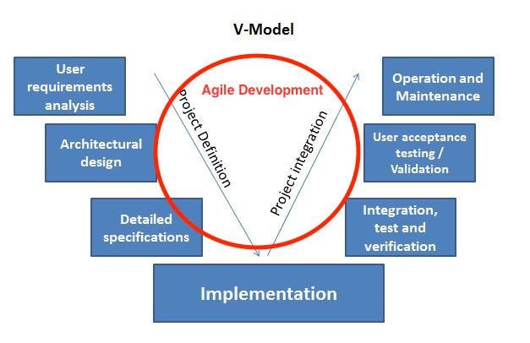
6. Development – Phases
V-Model
Integrated agile development
Source: https://sinergique.files.wordpress.com/2013/10/v-model-illustration.jpg, accessed on 08/24/17 at around 04:20 PM
Introduction
Technologies
Design
Architecture
Testing
Development
Conclusion
Demo
Notes:
Groß: V-Modell -> Requirements, Klassendiagramm
Implementierung, Testen -> Agil: wöchtenl. Treffen (Review, Code-Diskussion, ToDo-Liste)
„Sprints“:

Slide 22
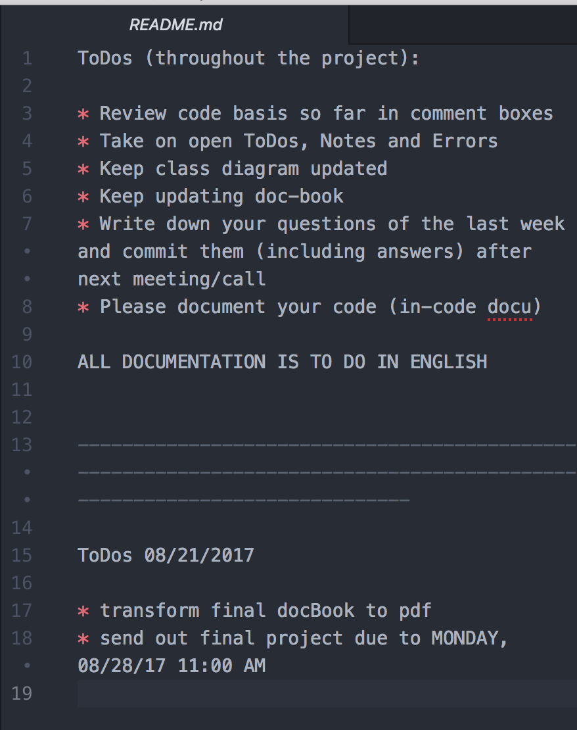
6. Development – Team work
Weekly team meetings
On-sight in Garching
Distributed: skype progress meetings
ToDos marked in holistic Readme file
ToDos marked in source code
Presentation and question rounds for each team member
Git version control with progress steps in commit messages
Introduction
Technologies
Design
Architecture
Testing
Development
Conclusion
Demo

Slide 23

7. Conclusion
Source: http://clipartix.com/wp-content/uploads/2016/04/Thumbs-up-clipart-cliparts-for-you.jpg, accessed on 08/24/17 at around 04:33 PM
Introduction
Technologies
Design
Architecture
Testing
Development
Conclusion
Demo

Slide 24

Reflection
Initial decisions and discussion of rules, game logic and flow was very important
Weekly:
Understanding code and asking questions lead to walkthroughs
Coordination across different time zones
Learning from each team member (code and work ethics)
Introduction
Technologies
Design
Architecture
Testing
Development
Conclusion
Demo

Slide 25
Challenges & Outlook
Challenges
Understanding the basic concept of XML web stack
BaseX, RestXQ and http server functionality
Improve GUI for good game flow
Outlook
Add special effects to GUI
Play on several machines
Introduction
Technologies
Design
Architecture
Testing
Development
Conclusion
Demo

Slide 26
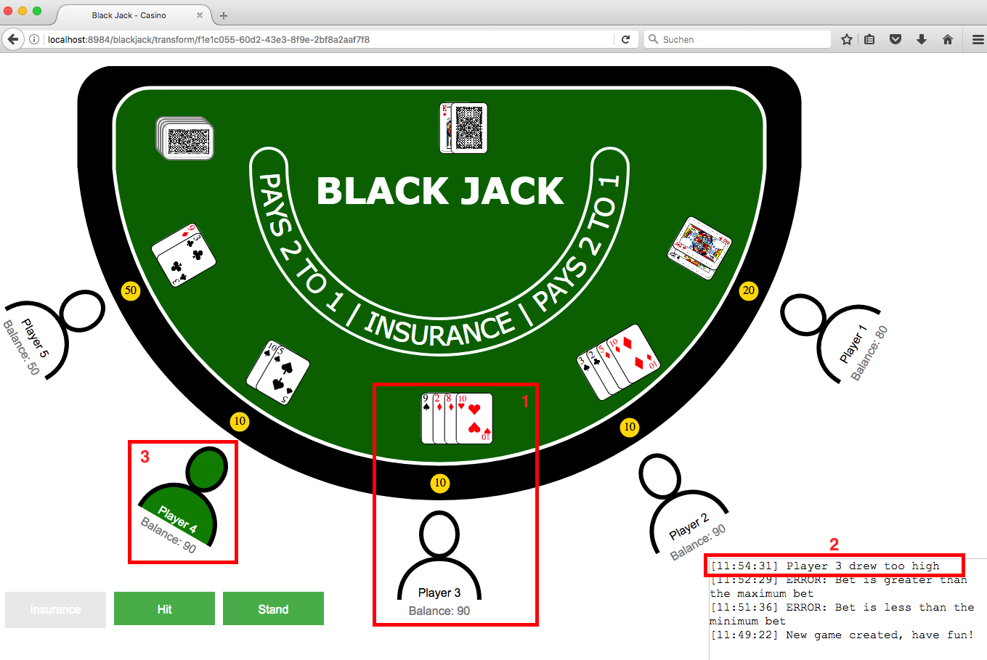
8. Demo – Overview GUI
Introduction
Technologies
Design
Architecture
Testing
Development
Conclusion
Demo

Slide 27
8. Demo – Live
Live-Demo
Introduction
Technologies
Design
Architecture
Testing
Development
Conclusion
Demo

Slide 28
Thank you very much!

Slide 29
Practical Course: XML Technology
Developers: Robert Urban, Anne-Catherine Seeser, Lennert Rienau,
Michael Mitterer, Manuel Ehler
Garching, 08/30/2017

Slide 30
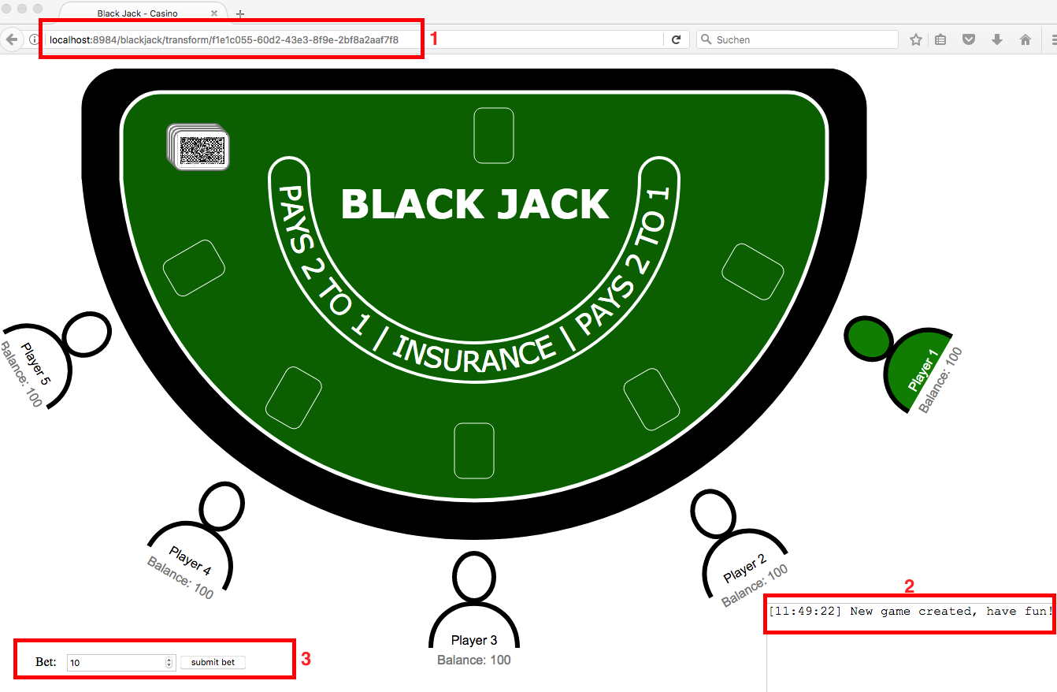
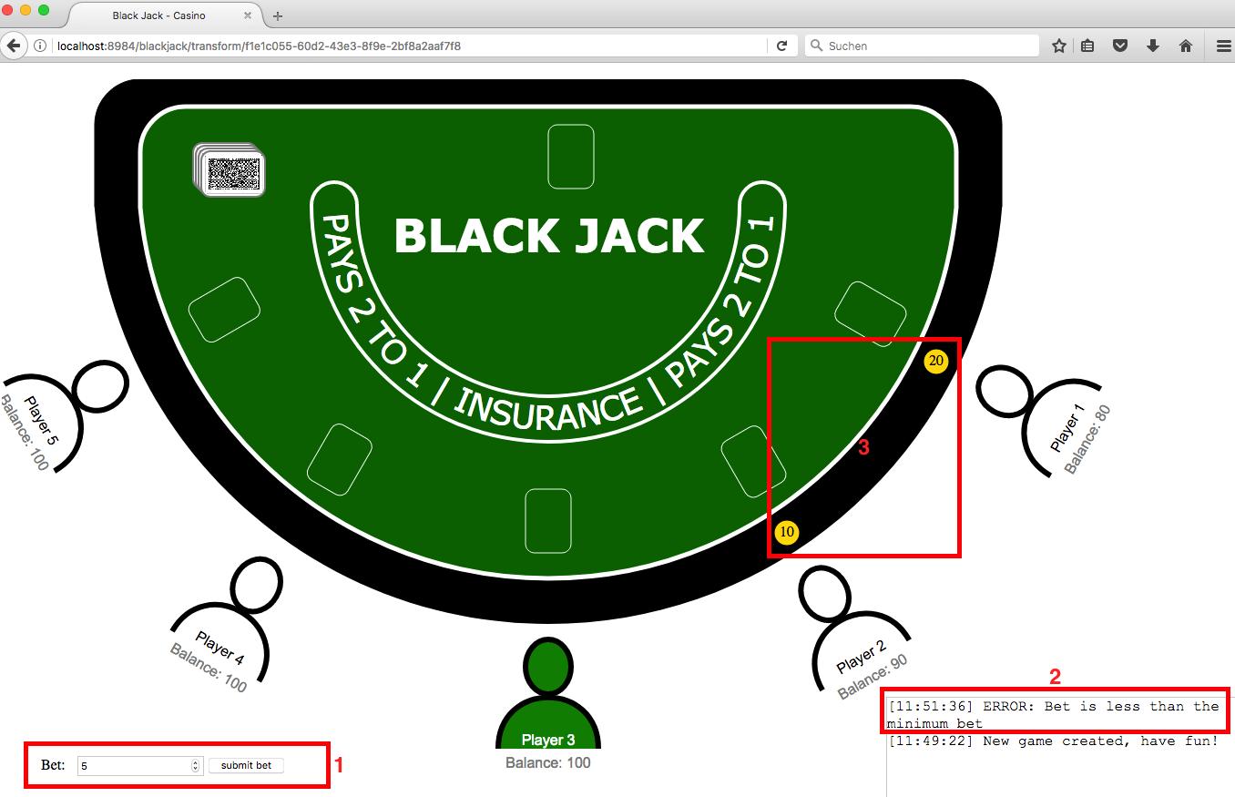
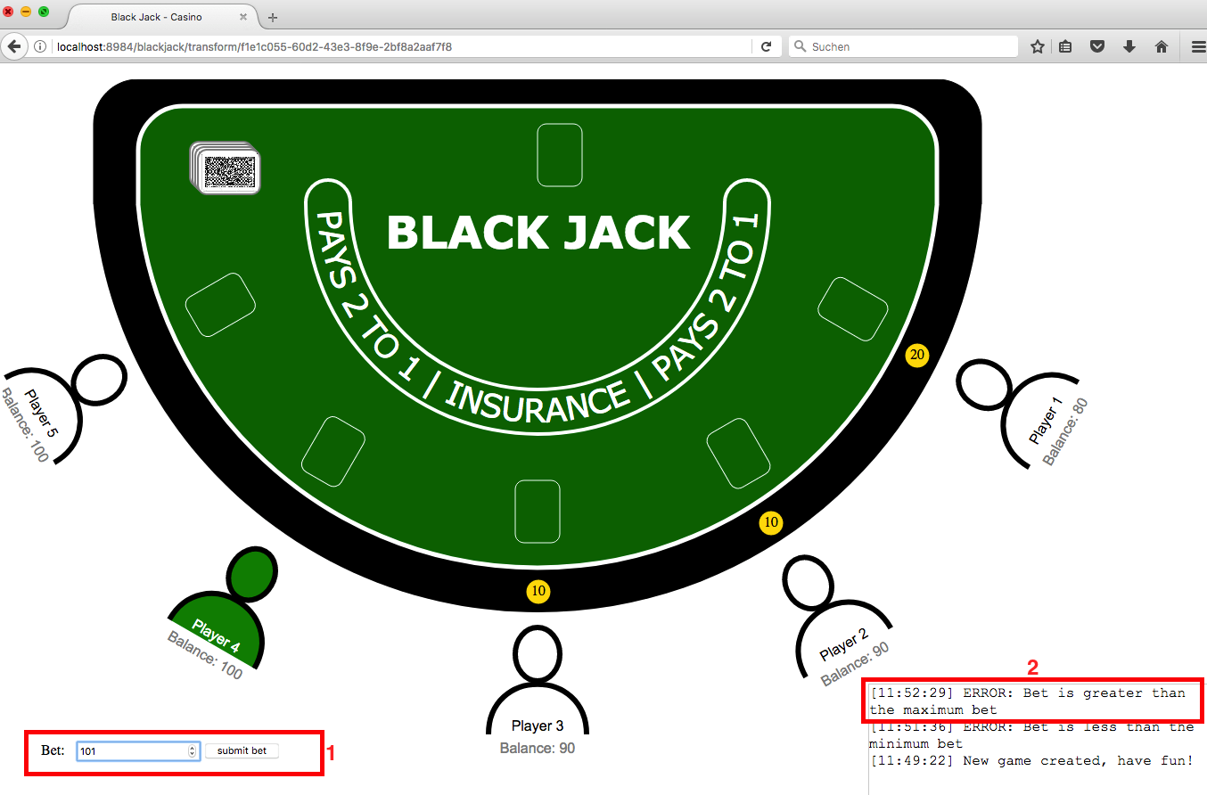
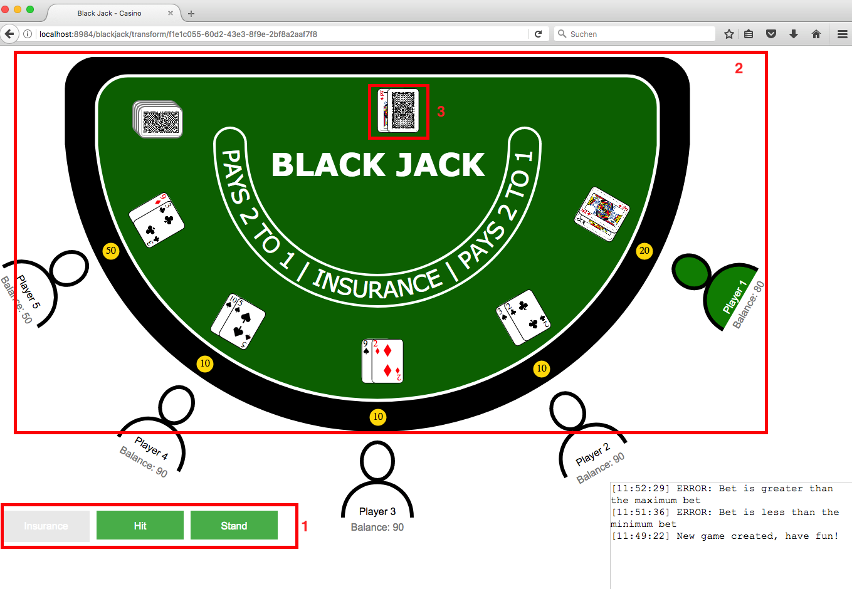
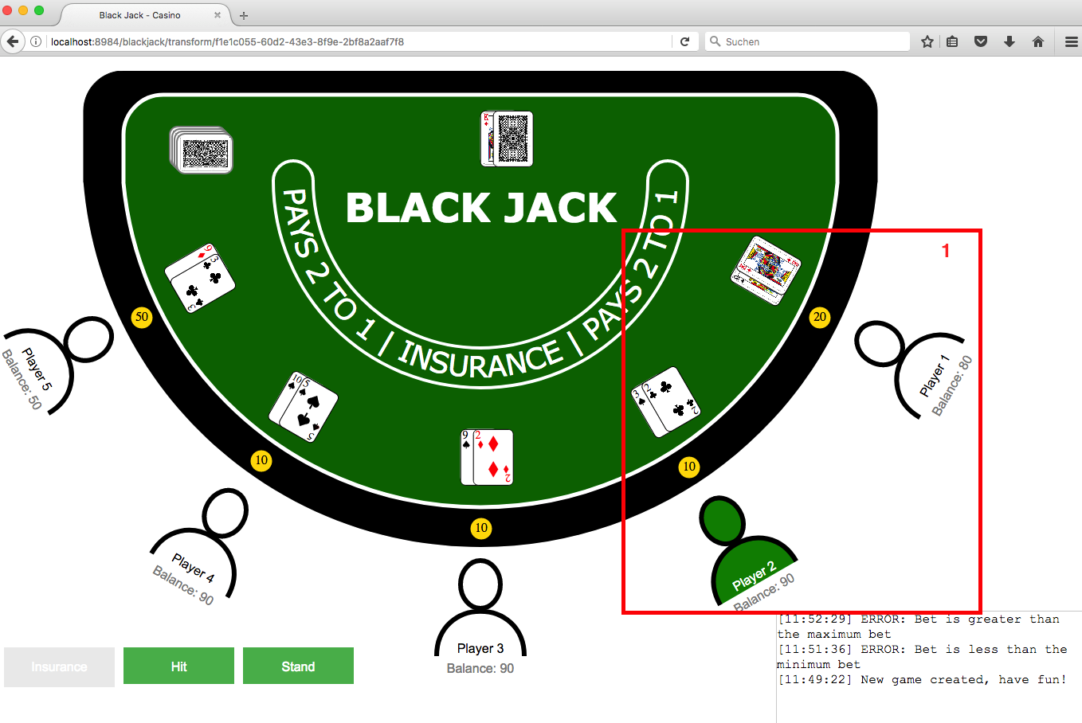
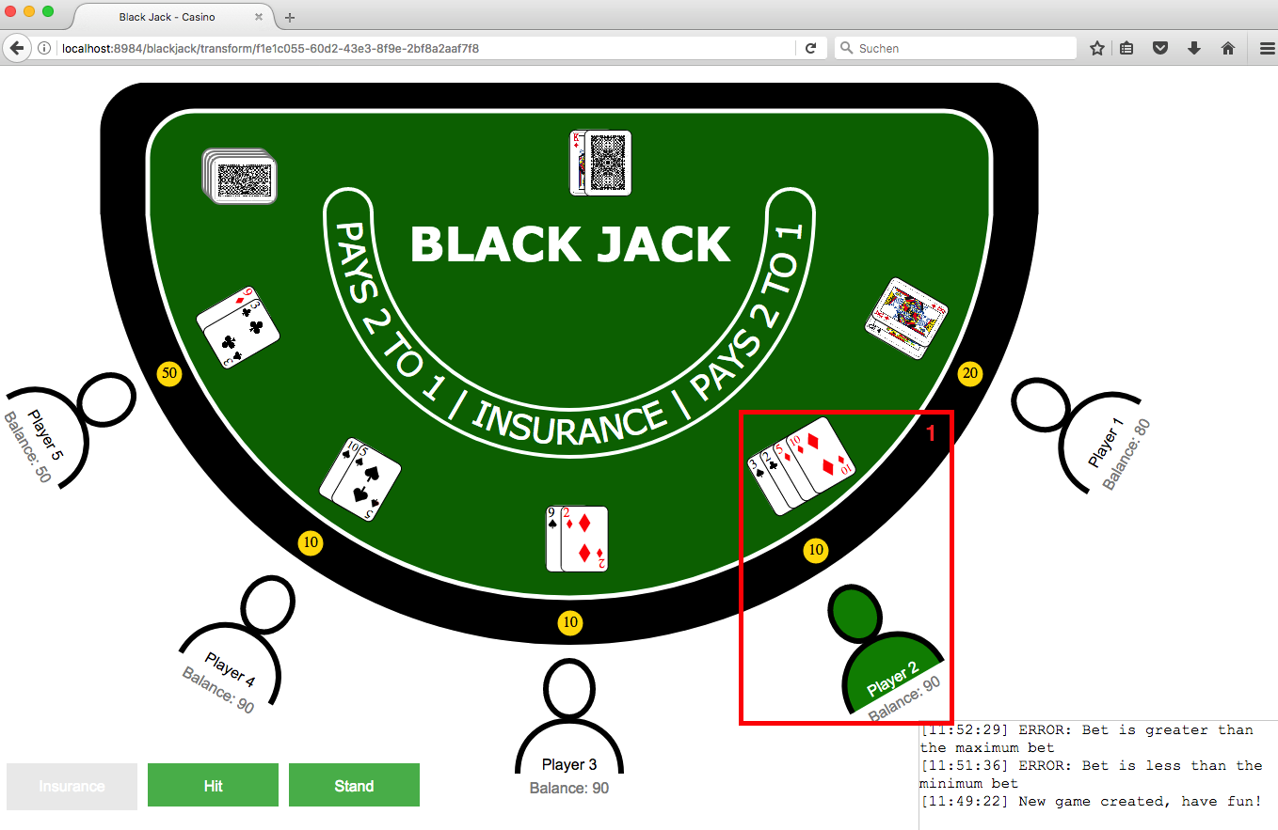
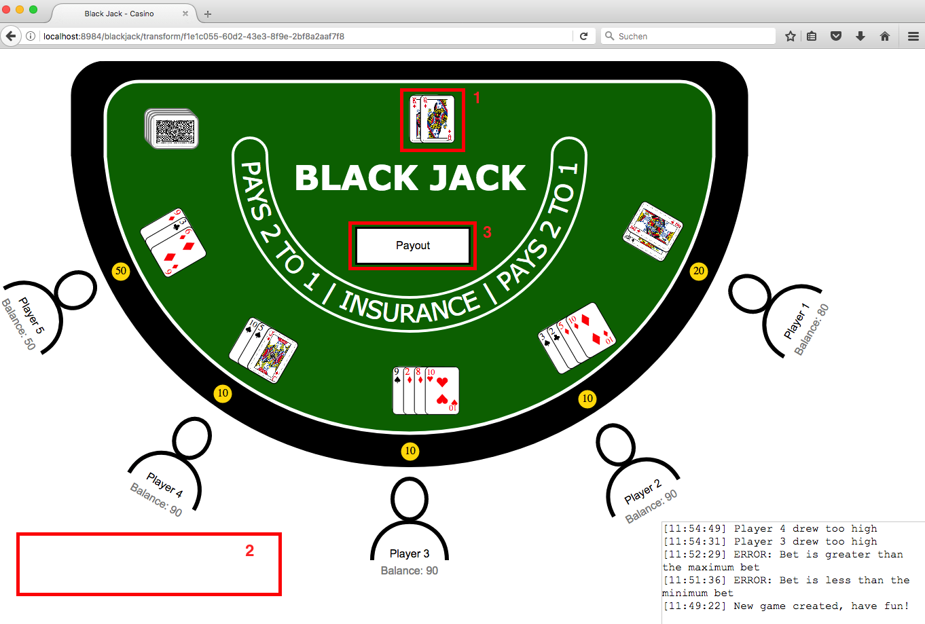
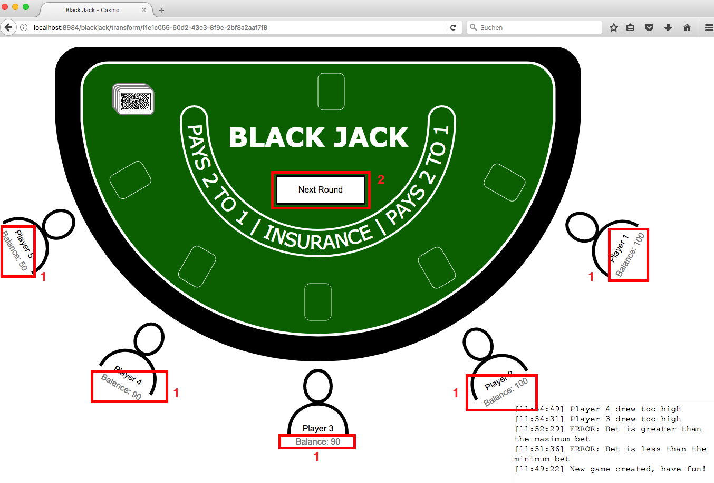
To 8. Demo

